Slide 1
Build portfolio website.
We deigned the team portfolio website using HTML, CSS and JavaScript,
with the help of github branch.
Here are some slides and details of our website .

Slide 2
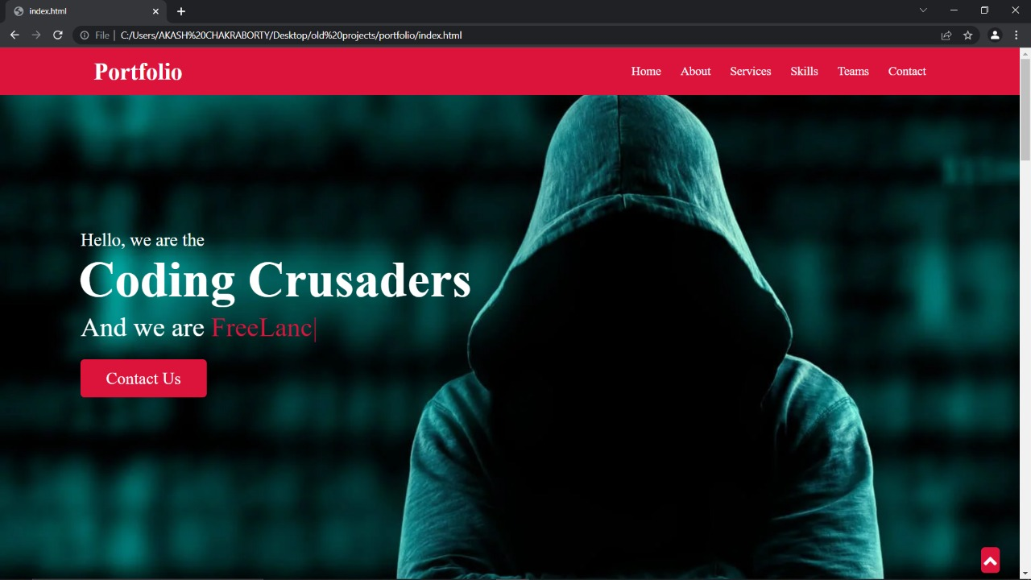
In header section there is a navbar to link the different section of the webpage by internal linking and skills of our team members.

Slide 3
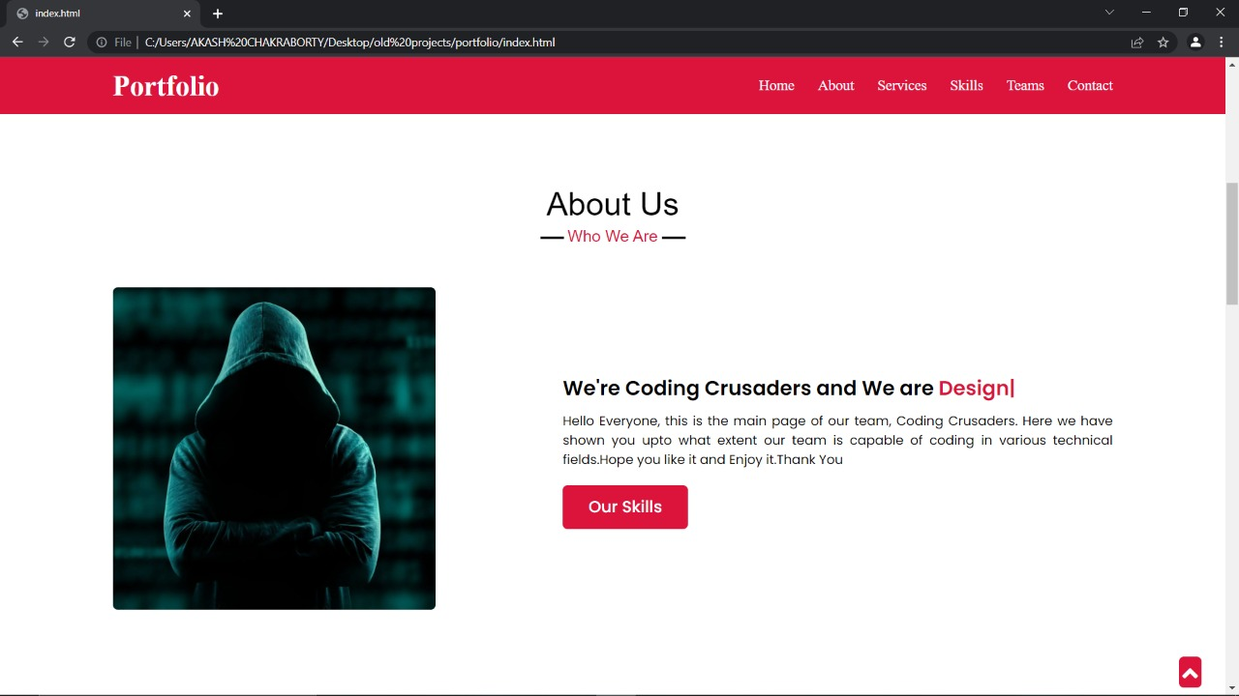
In next section there are brief description about our team Coding Crusaders.

Slide 4
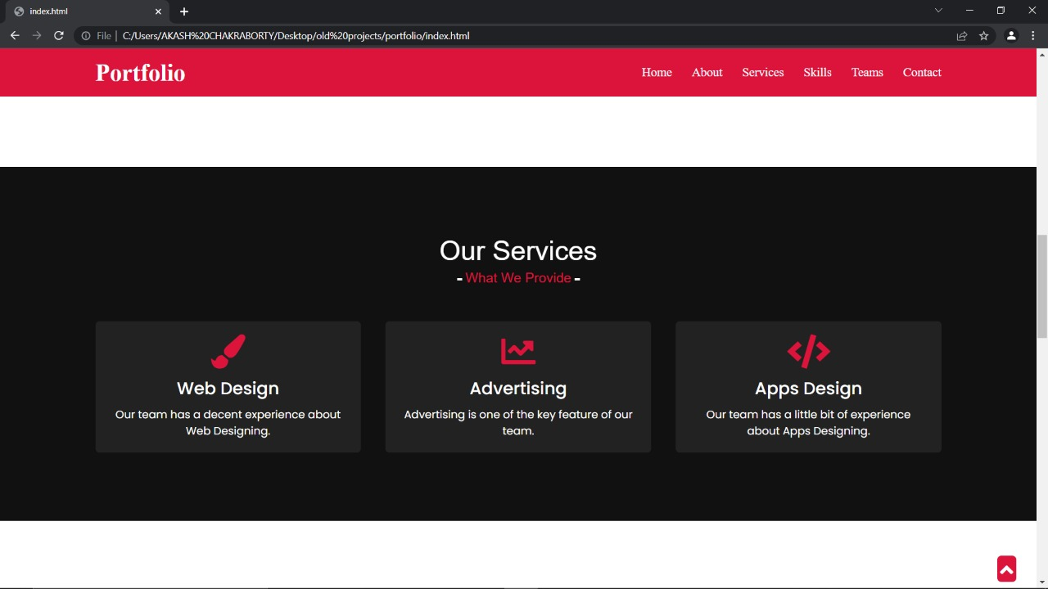
In this section there are the services that we provide using our skillset as a team.

Slide 5
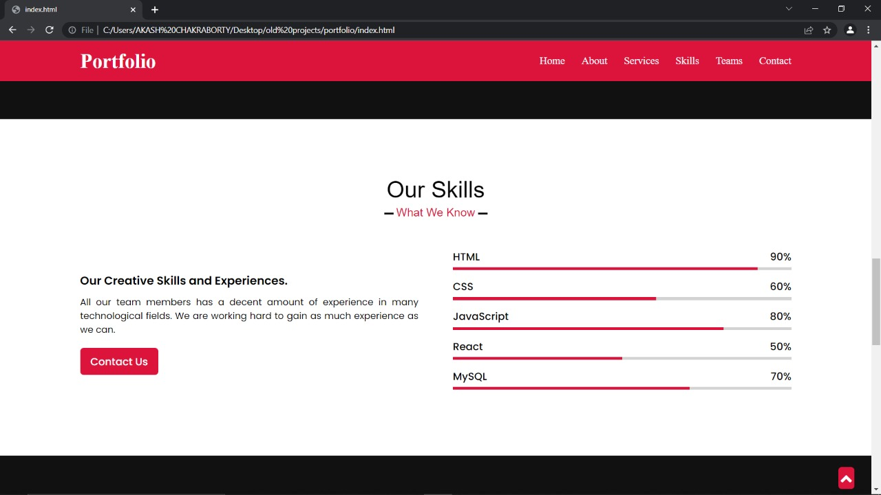
These are important skills of our teams.

Slide 6
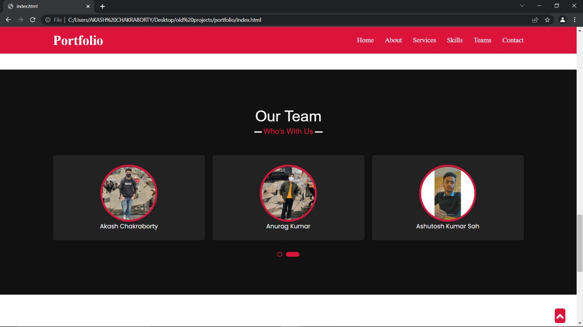
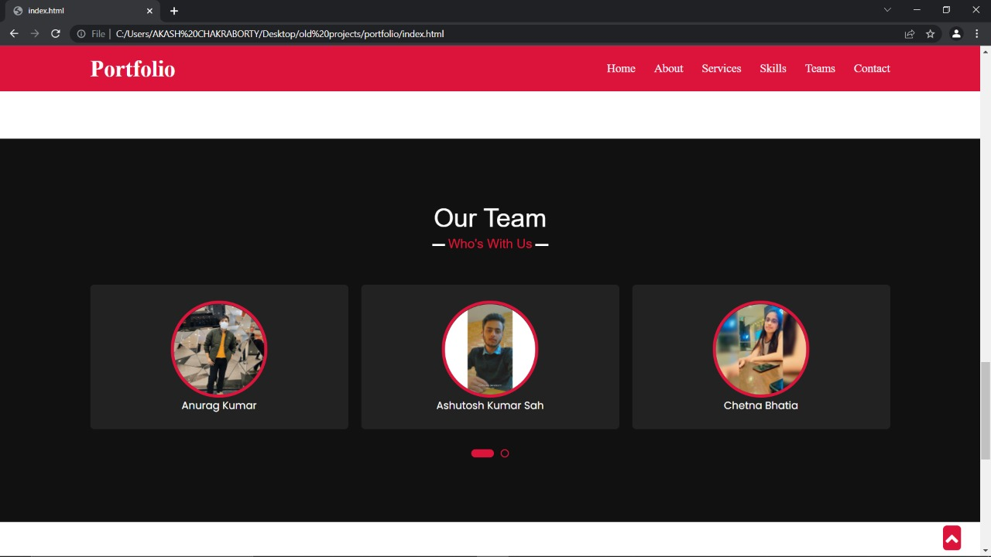
The names and profile of our team members.

Slide 7
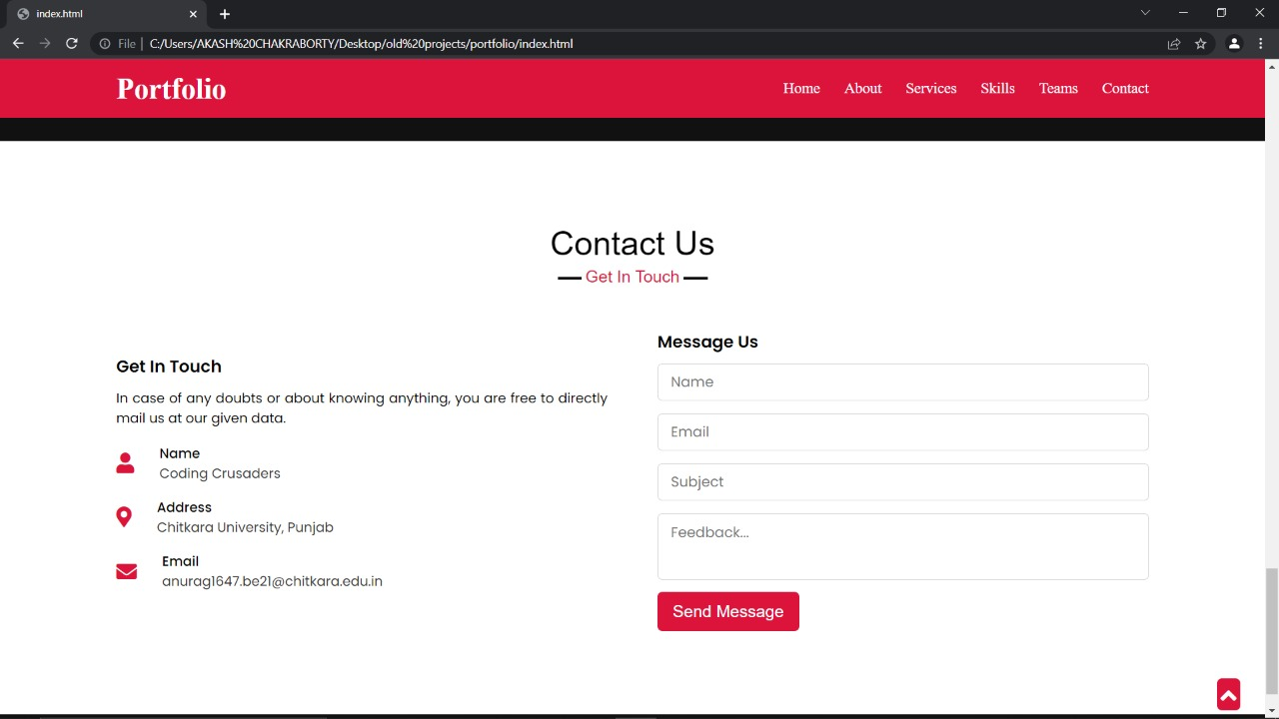
This is the contact and feedback page.

Slide 8
THANK YOU!

